Slide 1
AI Strategy and Digital Tranformation
Marc Ionescu

Slide 2
Outline
Chosen Models
Approach: Choosing the models
Results on Train Data
Decision Tree as the final model

Slide 3
Chosen Models
There are 6 models proposed for this project:
  Logistic Regression
  Kneighbours Classifier
  Support Vector Machine
  Decision Tree
  Random Forest
  Gradient Boosting

Slide 4
Logistic Regression
Advantages
  Interpretability
  Feature importance
  Popular in healthcare, finance and social sciences
  Disadvantages:
    Tend to overfit
    Assumes linear realtionships
    Need regularization
Sources:
  TargetTech
  GeeksforGeeks

Slide 5
Kneigbours Classiifier
Advantages
  No training phase
  Useful for irregular patterns
  Disadvantages:
    Computational intensive
    Memory Intensive
    Curse of dimensionality
    Need feature scaling
Sources:
  AppliedAICourse
  TrendSpider

Slide 6
Support Vector Machine
Advantages
  Interpretability
  Understands complex patterns
  Non-linear
  Disadvantages:
    Unscalable to larger datasets
    Less interpretable
Sources:
  FlyRank
  GeeksforGeeks

Slide 7
Decision Tree Classifier
Advantages
  Interpretability (Flowchart)
  Scaling Data Unnececssary
  Not sensitive to outliers
  Disadvantages:
    Overfitting
    Less interpretable for large trees
Sources:
  Medium
  GeeksforGeeks

Slide 8
Random Forest Classifier
Advantages
  Scaling Data Unnececssary
  Reduced Overfitting (ensemble)
  Trainining in paralell
  Disadvantages:
    Hard to explain
    Less interpretable
    Heavy model
Sources:
  Breiman (2001)
  GeeksforGeeks

Slide 9
Gradient Boosting Classifier
Advantages
  Builds trees sequentially
  Feature importance (interpretabililty)
  Complex Patterns
  Disadvantages:
    Overfitting
    Overwhelming Hyperparameters
    Heavy Model
Sources:
  Scikit Documentation
  GeeksforGeeks

Slide 10
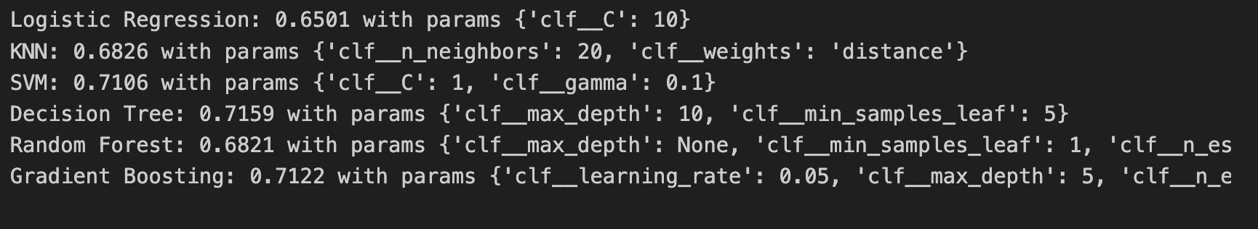
Approach: Choosing the models
Cross-validation
  Hyperparametrization:
    Lreg: "clf__C": [0.01, 0.1, 1, 10]
    KNN: "clf__n_neighbors": [5, 10, 20]
    SVM "clf__C": [0.1, 1, 10]
    DT:
      "clf__max_depth": [5, 10, 20, None]
      "clf__min_samples_leaf": [1, 5, 10]
    RF: "clf__n_estimators": [200, 500]
    GB:
      "clf__n_estimators": [100, 200]
      "clf__learning_rate": [0.05, 0.1]

Slide 11


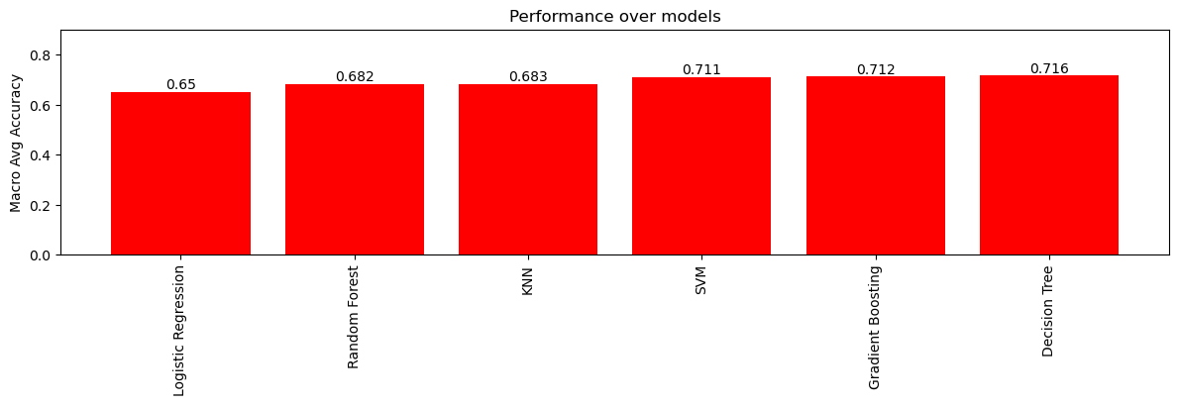

Results on Train Data
z
GitHub Link with all the models: https://github.com/ionASE-coder/AI-Strategy-and-Digital-Transformation-Project

Slide 12
Best Model: Decision Tree
  Hyperparameters: {'clf__max_depth': 10, 'clf__min_samples_leaf’: 5}
The balanced accuracy in CrossValidation: 71,6%
The balanced accuracy on training data, once fitted: 76,7%
The predicted balanced accuracy on test data…..70%

